Slide 1
Data Transformation in R
Session 4
Amrom Obstfeld
Introduction to R Workshop
July 17, 2020

Slide 2
July 16 2020 | Session | Instructor
1:00 pm - 1:30 pm | Instructor Introductions, Introduction to technology | Amrom Obstfeld
1:30 pm - 2:15 pm | Introduction to R and RStudio | Joe Rudolf
2:30 pm - 3:15 pm | R basics for Reproducible Reporting | Patrick Mathias
3:30 pm - 5:00 pm | Data Visualization in R | Stephan Kadauke
July 17 2020
1:00 pm - 2:30 pm | Data Transformation | Amrom Obstfeld
2:45 pm - 4:15 pm | Statistical Analysis in R | Dan Herman
4:30 pm - 5:00 pm | Advanced Reporting in R | Patrick Mathias

Slide 3
Goals and Objectives
Learn how to:
Select and filter data of interest from a large dataset
Create new columns from raw data

Slide 4
Typical Data Science Pipeline

Slide 5


What is a “Tidy” Data Frame
A data set is tidy if:
Each variable is in its own column
Each observation is in its own row
Each value is in its own cell

Slide 6

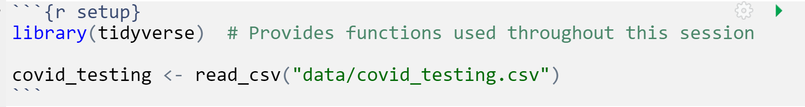
Your Turn 1
Open "04-Transform.Rmd" Run the setup chunk
Notes:
Raise your hand when you have finished this step

Slide 7
Your Turn 1
How can you confirm that you have successfully loaded the data file into Rstudio?
1. The code that imported the data did not yield an error
2. Code that references `covid_testing` object runs without errors
3. The `covid_testing` object is present in the environment pane
4. All of the above

Slide 8
Your Turn 1
How can you confirm that you have successfully loaded the data file into Rstudio?
1. The code that imported the data did not yield an error
2. Code that references `covid_testing` object runs without errors
3. The `covid_testing` object is present in the environment pane
4. All of the above

Slide 9

dplyr

Slide 10

Transform Data with
Notes:
After collecting and loading data, almost all datasets need to be cleaned in some way. The dplyr package provides functions to carve, expand, and collapse a data frame that will cover 95% of use cases.

Slide 11
dplyr
dplyr implements a grammar for transforming tabular data.
11
Notes:
Getting your data into this format requires some upfront work, but that work pays off in the long term. Once you have tidy data and the tidy tools provided by packages in the tidyverse, you will spend much less time munging data from one representation to another, allowing you to spend more time on the analytic questions at hand. The dplyr package provides functions that begin this process, they help you carve, expand, and collapse data.

Slide 12
dplyr: a grammar for transforming data
1
Extract existing variables.
select()
2
Extract existing rows.
filter()
3
Derive new variables.
mutate()
4
summarize()
Change the unit of analysis.
Notes:
What do I mean by a grammar for transforming data.
Dplyr facilitates data manipulation by providing a set of verbs that operate on data using a consistent syntax and that solve the most common data manipulation challenges that we face in data analysis in general and in clinical data science more specifically.

Slide 13
common syntax
Each function takes a data frame as its first argument and returns a data frame as its output.
filter(data, ...)
dplyr function
data frame to transform
specific arguments
13
Notes:
One of the major advantages of using dplyr functions in your data analysis is that dplyr functions all use a common syntax, which makes them easier to learn.
Each one will take a data frame as the first argument, and there will then be other arguments that basically serve as instructions to the function on how to operate on the data frame.
And by arguments I mean options that we can set within the function that will determine how that function will work

Slide 14
Isolating data
Notes:
The first set of functions we will explore will be ones whose primary goal is to isolate the data of interest from a large pile of other data.

Slide 15
Isolating data
Extract columns with select().
Extract rows with filter().
Arrange rows, with arrange().
Notes:
We will start with three functions that are handy ways to find the data you’re interested in the large laboratory datasets regularly dumped on you. Reducing a data set to a subset of columns and/or rows are common operations in data analysis, particularly on the path to answering a specific set of questions about a data set.

Slide 16

select()
Notes:
We will start slowly, with the select function. It’s not uncommon to get datasets with hundreds or even thousands of variables. In this case, the first challenge is often narrowing in on the variables you’re actually interested in. select() allows you to rapidly zoom in on a useful subset using operations based on the names of the variables.

Slide 17
select()
Extract columns from a data frame
= Number of rows
↓ Number of Columns
17
Notes:
Select does one thing but does it well. It extracts columns of your choosing from a data frame and returns these columns as a new data frame. In the output, you will wind up with all the rows that you started with and the columns defined in the select function.

Slide 18
select()
Extract columns from a data frame
select(data,... )
data frame to transform
name(s) of columns to extract
(or a select helper) function)
dplyr function
data frame to transform
Notes:
Select takes the starting data frame as its first argument, "data".
After that it takes any number of additional arguments that specify the columns that you want to pick. In it’s simplest form, those additional arguments will just be the names of the columns that you want to select. However, in very wide datasets, writing out the names of the columns you want can sometimes be laborious. It doesn’t scale well. That’s why the developers of the dplyr function have added several convenience functions that can more succinctly identify the columns you want. We’ll cover that after the next exercise.

Slide 19
select()
Extract columns from a data frame
select(data,... )
select(covid_testing, mrn, last_name)
data frame to transform
name(s) of columns to extract
(or a select helper) function)
data frame to transform
19
Notes:
Let’s take a look at the orders data frame that we loaded earlier in the lesson, for example.
The select statement will take the data frame ‘covid_testing’, and return a new data frame that only has the columns `mrn` and `last_name`.
You could list as many or as few column names as you want in the select function, it will bring back everything you list.

Slide 20
select()
Extract columns from a data frame by name
select(covid_testing, mrn, last_name)
covid_testing
description | department
PROTHROMBIN TIME | INTERNAL MEDICINE CLINIC
BASIC METABOLIC PANEL | INTERNAL MEDICINE CLINIC
THYROID STIMULATING HORMONE | ENDOCRINOLOGY CLINIC
T4, FREE | ENDOCRINOLOGY CLINIC
mrn | first_name | last_name | gender
5000876 | sarella | stark | female
5006017 | alester | stark | male
5001412 | jhezane | westerling | female
5000533 | penny | targaryen | female
mrn | last_name
5000876 | stark
5006017 | stark
5001412 | westerling
5000533 | targaryen
…
…
Notes:
So, if you were to use the code above, the covid_testing data frame would be accepted as input and a subset of it, the mrn and the last_name would be returned as output

Slide 21
c() is a little function in R that combines two or more values into a vector
select()
Extract columns from a data frame index
select(covid_testing, c(1,3))
covid_testing
description | department
PROTHROMBIN TIME | INTERNAL MEDICINE CLINIC
BASIC METABOLIC PANEL | INTERNAL MEDICINE CLINIC
THYROID STIMULATING HORMONE | ENDOCRINOLOGY CLINIC
T4, FREE | ENDOCRINOLOGY CLINIC
mrn | first_name | last_name | gender
5000876 | sarella | stark | female
5006017 | alester | stark | male
5001412 | jhezane | westerling | female
5000533 | penny | targaryen | female
mrn | last_name
5000876 | stark
5006017 | stark
5001412 | westerling
5000533 | targaryen
…
…
Notes:
Select is very flexible in terms of the ways that you can specify the columns you do or don’t want in the output. Here I’m showing you that I can give a numeric index of the columns that I want, in this cases the first and the fourth, and select dutifully provides these in the output. Note that when listing out these indexes one should put them in the ‘c’ (which stands for combine) function.

Slide 22
Your Turn 2
Alter the code to select just the first_name column using (1) column name and (2) column number
If you have time, see if you can select first_name using a numeric index
select(covid_testing, _____)

Slide 23
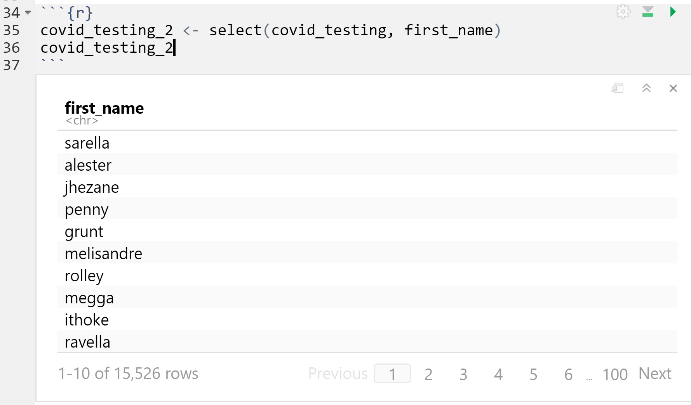
select(covid_testing, first_name)
select(covid_testing, 2)
23

Slide 24

select() helpers
: -- Select range of columns
select(covid_testing, mrn:last_name)
– -- Select every column but
select(covid_testing, -c(test_id, demo_group))
starts_with() --Select columns that start with… with…
select(covid_testing, starts_with("p"))
ends_with() --Select columns that end with…
select(covid_testing, ends_with("tat"))
24
Notes:
Select provides many convenient ways to specify which columns you want. For instance, you can put the name of two columns separated by a colon mark, and select will return those two columns and all those in between. With select you could put a negative sign in front of a column name or a vector of column names and you'll get back everything except those columns. Then there's other functions that you can use inside of select that provide even more flexibility around defining which columns you want. For instance, you can use special function like starts_with and ends_with to instruct select on which columns you want based on a string.

Slide 25
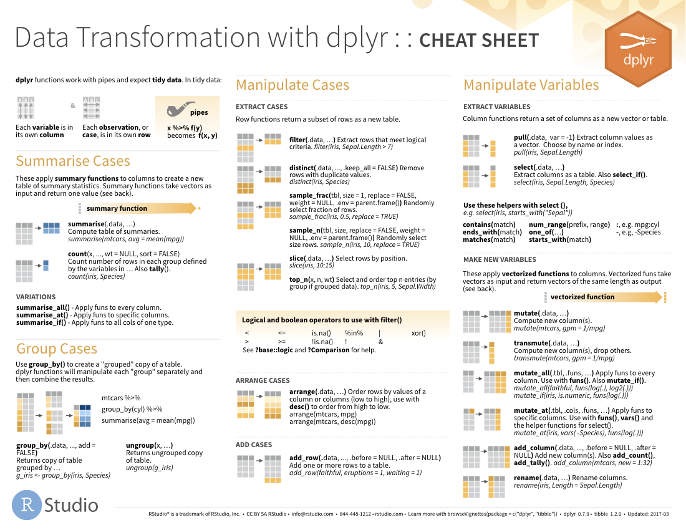
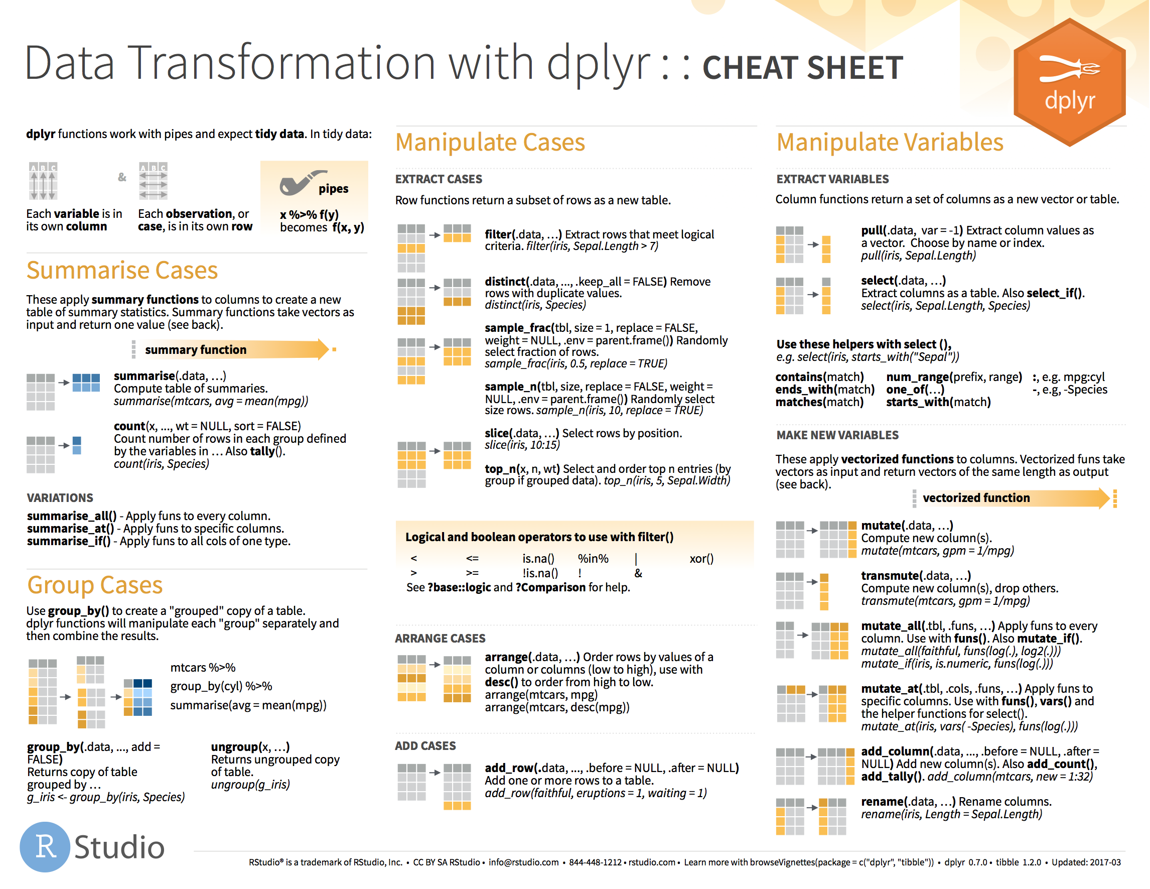

select() helpers
25
Notes:
I’ve only listed for you a selection of the available ways you can use helpers with select() to pull out the columns you need for your analysis. For a more complete list, see the select() section on the dplyr cheatsheet,

Slide 26
Your Turn 3
Your Turn 3
The turnaround time metrics are found in columns 16 and 17 and are labeled `col_rec_tat` and `rec_var_tat`. Which of these could you use to remove these columns?
A) select(covid_testing, -16,-17)
B) select(covid_testing, -col_rec_tat, -rec_ver_tat)
C) select(covid_testing, -contains("tat"))
D) all of the above
Notes:
Hint: Review the columns in the dataset by clicking on the arrow next to the covid_testing data set in the environment tab in the upper right pane of Rstudio

Slide 27
Your Turn 3
Your Turn 3
The turnaround time metrics are found in columns 16 and 17 and are labeled `col_rec_tat` and `rec_var_tat`. Which of these could you use to remove these columns?
A) select(covid_testing, -16,-17)
B) select(covid_testing, -col_rec_tat, -rec_ver_tat)
C) select(covid_testing, -contains("tat"))
D) all of the above

Slide 28
filter()
Notes:
Now let's carve the data set in the other direction. If you need only a subset of rows from your data set, `filter()` allows you to pick rows (cases) based on criteria that you choose, meaning you can subset your data based on logical criteria.

Slide 29
filter()
Extract rows that meet logical criteria
↓ Number of rows
= Number of Columns

Slide 30
common syntax
Each function takes a data frame as its first argument and returns a data frame as its output.
filter(data, ...)
dplyr function
data frame to transform
specific arguments

Slide 31
filter()
Extract rows that meet logical criteria
filter(data,... )
one or more logical tests (filter returns each row for which the test is TRUE)
data frame to transform
31
Notes:
The syntax for filter is very similar to what we used for select. The first argument is a data frame from which we will be selecting rows. Afterwards we can input one more logical tests. R then performs that logical test on each row of the dataset and returns all rows in which the logical test was TRUE. Rows for which the tests are TRUE are returned in the output as a data frame.

Slide 32
filter()
Extract rows that meet logical criteria
filter(covid_testing, mrn==5000083)
mrn | first_name | last_name
5000876 | sarella | stark
5006017 | alester | stark
5001412 | jhezane | westerling
5000083 | lollys | clegane
mrn | first_name | last_name
5000083 | lollys | clegane
FALSE
FALSE
FALSE
TRUE
Notes:
Here we supply the orders data frame as the first argument. Afterwards we provide one logical test; we ask filter() to return rows in which the mrn is 5000083.

Slide 33
filter()
Extract rows that meet logical criteria
filter(covid_testing, mrn==5000083)
mrn | first_name | last_name
5000876 | sarella | stark
5006017 | alester | stark
5001412 | jhezane | westerling
5000083 | lollys | clegane
= sets
(returns nothing)
== tests if equal
(returns TRUE or FALSE)
data frame to transform
Notes:
Note that I used double equals inside of the logical test. Double equals means: compare the left hand side to the right hand side and if it’s the same, then return TRUE. The double equals is called the comparison operator. In contrast, a single equals sign sets a variable (usually the left side) to a value (usually on the right). It is a very common mistake to accidentally use a single equals inside of the filter function, which will result in an error.

Slide 34
filter()
Values coded as character strings must be surrounded by quotes
Extract rows that meet logical criteria.
filter(covid_testing, last_name=="stark")
mrn | first_name | last_name
5000876 | sarella | stark
5006017 | alester | stark
5001412 | jhezane | westerling
5000083 | lollys | clegane
mrn | first_name | last_name
5000876 | sarella | stark
5006017 | alester | stark
TRUE
TRUE
FALSE
FALSE
Notes:
Similarly we can ask filter to return just the rows that represent a tests for a specific patient, like stark. Note that when asking filter to return rows with specific text inside of it, we have to put that text in quotes.

Slide 35
filter()
Extract rows that meet logical criteria
filter(data,... )
one or more logical tests (filter returns each row for which the test is TRUE)
data frame to transform
Notes:
So what we've seen is that the output of a filter() function is completely dependent on the logical operators in this green square. Logical statements that result as TRUE are returned and those that are FALSE will not be returned. So the next question of course is how do you construct logical statements in R.

Slide 36
1 > 2
# FALSE
36

Slide 37
x <- 1
x > 2
# FALSE
37

Slide 38
x <- c(1, 2, 3)
x > 2
# FALSE FALSE TRUE
38

Slide 39
filter()
Extract rows that meet logical criteria.
filter(covid_testing, last_name=="stark")
mrn | first_name | last_name
5000876 | sarella | stark
5006017 | alester | stark
5001412 | jhezane | westerling
5000083 | lollys | clegane
mrn | first_name | last_name
5000876 | sarella | stark
5006017 | alester | stark
TRUE
TRUE
FALSE
FALSE

Slide 40
Pop Quiz
What is the result?
1 == 1

Slide 41
Pop Quiz
What is the result?
1 == 1
TRUE

Slide 42
Pop Quiz
What is the result?
"one" == "One"

Slide 43
Pop Quiz
What is the result?
"one" == "One"
FALSE

Slide 44
Logical tests
x < y | Less than
x > y | Greater than
x == y | Equal to
x <= y | Less than or equal to
x >= y | Greater than or equal to
x != y | Not equal to
x %in% y | Group membership
is.na(x) | Is NA
!is.na(x) | Is not NA
Notes:
Here are just some of the important logical operators to know about.
We’ve already seen the double equals. Note the less than or and greater than operators. These operators also come as “or equal to” versions.
Use != if you want to select rows in which a value is not equal to something else.
is.na is how you can test for missing values. This can be very useful as often times you want to remove missing values.
Note that in these examples x always represents the name of a column in your data frame.

Slide 45
Your Turn 4
Use filter() with the logical operators to find:
Every test for patients over age 80
All of the covid testing where the demographic group (demo_group) is equal to "client"
CHALLENGE:
All of the covid testing where the patient class (patient_class) is NA [Hint: See slide titled "Logical Tests"]

Slide 46
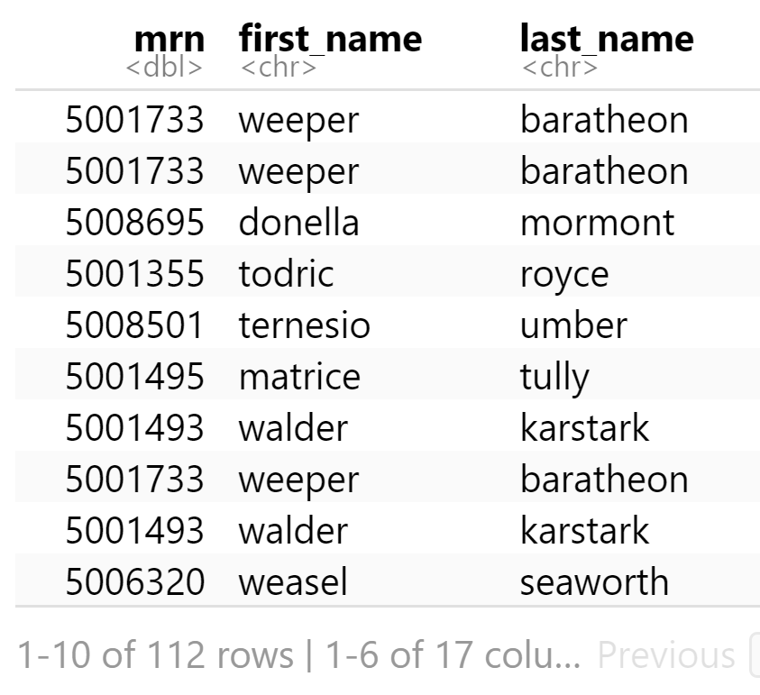
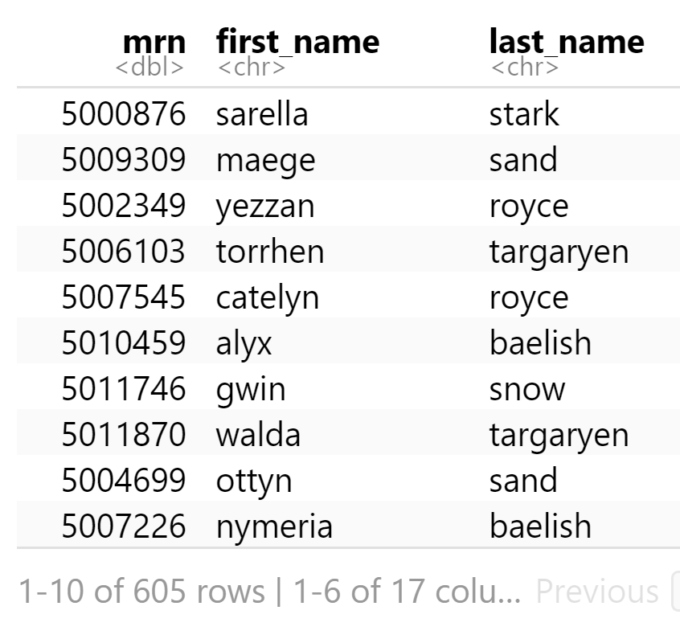
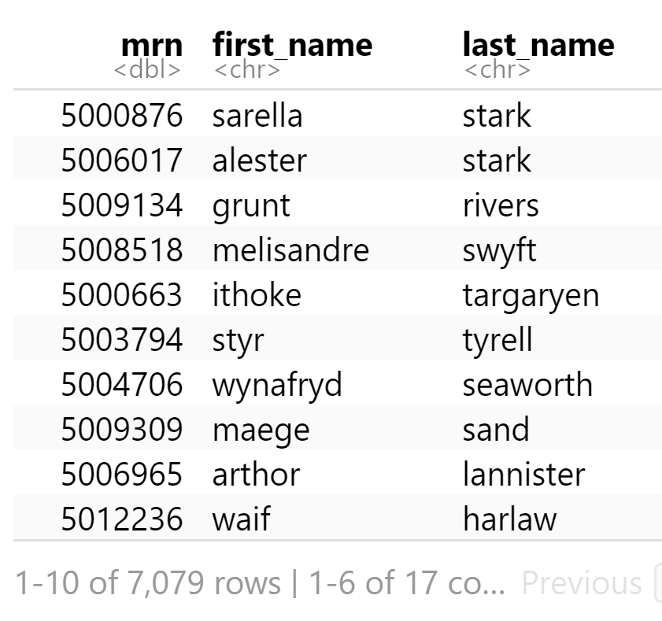
filter(covid_testing, age > 80)
filter(covid_testing, demo_group == "client")
filter(covid_testing, is.na(patient_class))

Slide 47
Boolean operators
?base::Logic
a & b | and
a | b | or
!a | not
( ) | group tests & evaluates first
Notes:
Now sometimes one logical statement is just not enough, you need something more complex
You have a variety of operators with which to join two or more logic statements.
You could tell filter to join two logical tests using the ‘&’ symbol. You can include an ‘or’ condition using the pipe character |, e.g. condition A | condition B.
Both in dplyr and throughout R the exclamation point ! is used as a negation.
And you have access to parentheses to group tests and specify order of operation

Slide 48
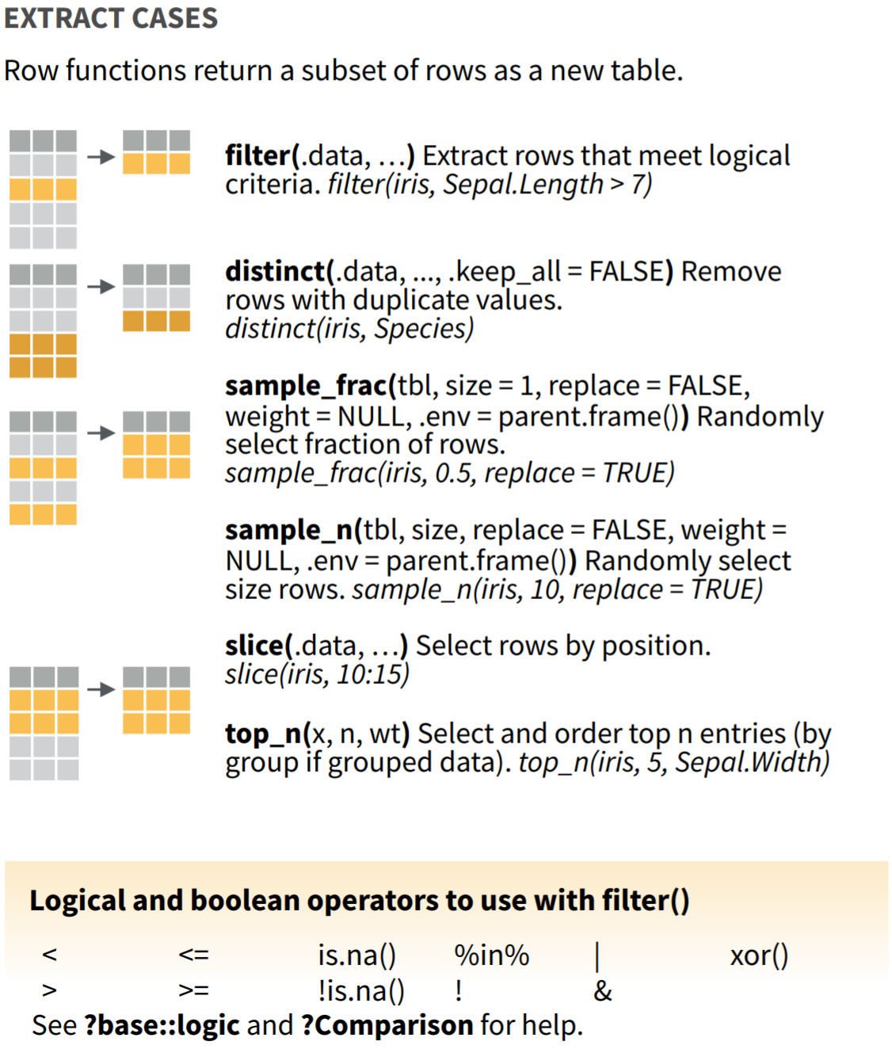
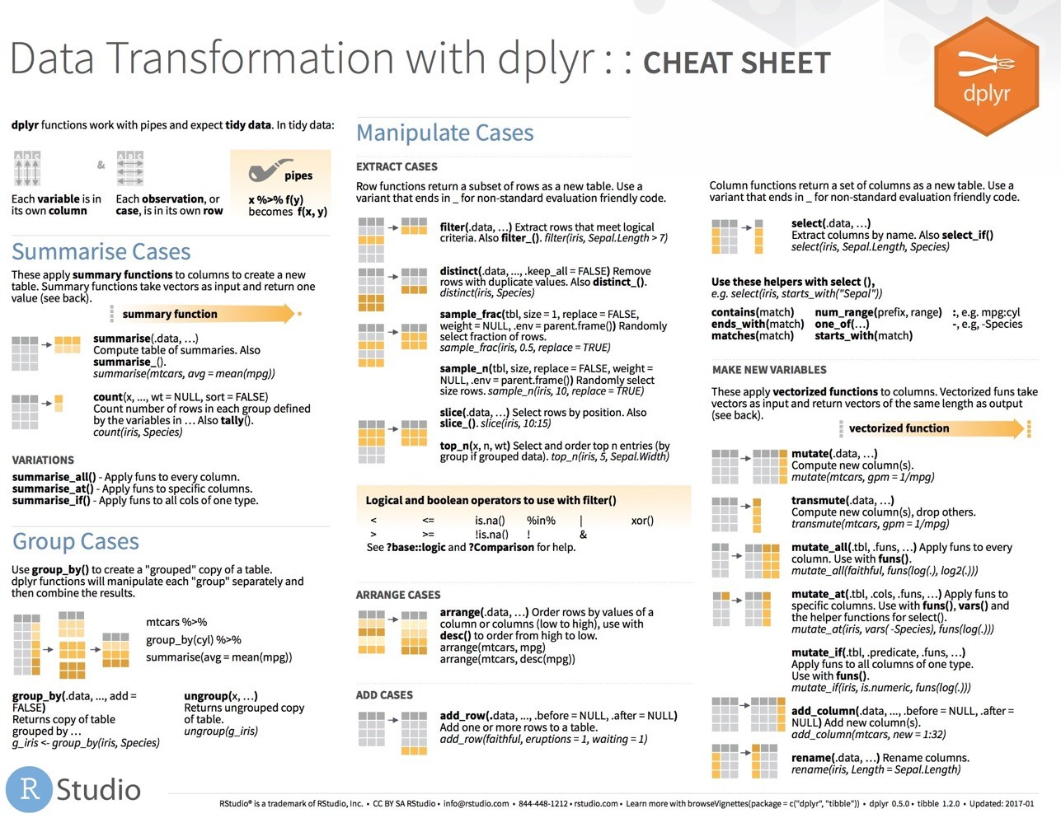
filter() variants
Notes:
Now filter() is only one of many functions that dplyr provides to allow you to extract the rows you want from your data. For a more comprehensive sampling see the Manipulate cases section on the dplyr cheatsheet.

Slide 49
arrange()

Slide 50
arrange()
Order rows by values in a column
= Number of rows
= Number of Columns
Notes:
Often when exploring your data you’ll be interested in organizing the rows according to values in a specific column or columns. That’s what arrange() does. It let’s you focus on the most important parts of your data by rearranging and organizing it.

Slide 51
arrange()
Order rows by values in a column
arrange(data,... )
data frame to transform
name(s) of columns to arrange by
Notes:
As we’ve seen, dplyr functions all have similar syntax and arrange is no exception. The data frame is your first argument. After that you can list one or more columns, each separated by a column, to arrange the data frame by.

Slide 52
arrange()
Order rows by values in a column
arrange(orders, first_name)
mrn | first_name | last_name
5000876 | sarella | stark
5006017 | alester | stark
5001412 | jhezane | targaryen
5000533 | penny | targaryen
mrn | first_name | last_name
5006017 | alester | stark
5001412 | jhezane | targaryen
5000533 | penny | targaryen
5000876 | sarella | stark
Notes:
In this example we are arranging covid_testing data frame by the first_name, which allows us to review the orders in the order in which the results were generated, rather than the seemingly haphazard way they have been exported in this data set.

Slide 53
arrange()
Order rows by values in a column
arrange(orders, desc(mrn))
mrn | first_name | last_name
5000876 | sarella | stark
5006017 | alester | stark
5001412 | jhezane | targaryen
5000533 | penny | targaryen
mrn | first_name | last_name
5006017 | alester | stark
5001412 | jhezane | targaryen
5000876 | sarella | stark
5000533 | penny | targaryen
Notes:
Sometimes we’ll be interested in viewing the patients ordered by mrn. By default arrange will order the rows from smallest to largest, from a to z, or from earliest date to latest. We can reverse this by wrapping our column of interest in the desc() function.

Slide 54
arrange()
Order rows by values in a column
arrange(orders, last_name, first_name)
mrn | first_name | last_name
5000533 | penny | targaryen
5006017 | alester | stark
5001412 | jhezane | targaryen
5000876 | sarella | stark
mrn | first_name | last_name
5006017 | alester | stark
5000876 | sarella | stark
5001412 | jhezane | targaryen
5000533 | penny | targaryen
Notes:
Let’s say we want to arrange the orders by patient first, and then by date. When listing only one column, ties will be arranged on the basis of the order they appeared in the original data frame. However if two columns are listed then the second column will be used as a tie-breaker. Additional columns can be added to further order tied rows.

Slide 55
Your Turn 5
The column `ct_result` contains the cycle threshold (Ct) for the real-time PCR that generated the final result.
How might you use arrange() to determine the highest and lowest Ct result in the dataset?

Slide 56
Pop Quiz
The default behavior of arrange() is to order from lower to higher values.
When might arrange() place "1000" before "50"?

Slide 57
%>%
Notes:
Now that we have a decent toolkit of functions with which to manipulate our data we should take a step back and talk about the data analysis process.
In any real data manipulation task you're probably not just going to use one verb but you're going to string multiple verbs together into a series of steps that overall accomplish a goal.

Slide 58
Data Analysis Steps
day_10 <- filter(covid_testing, pan_day <= 10)
Which patient locations sent COVID testing in the first 10 days of the pandemic?
day_10 <- select(day_10, clinic_name)
day_10 <- arrange(day_10 , clinic_name)
1. Filter tests to those on pandemic day less than 10
2. Select the column that contains ordering location
3. Arrange those columns by location
Notes:
For instance, in the context of the orders data set, one may investigate the ordering of tests that are not recommended for routine use, such as 1,25 dihydroxy vitamin D. The 25-hydroxy vitamin D level is the preferred test for screening for vitamin D deficiency. The 1,25 dihydroxy vitamin D level is used in rare and unique clinical situations, however it is often ordered by unwitting providers. To determine who is ordering the non-recommended test, one could start by filtering to the relevant test, select the columns that were necessary, and then maybe arrange the rows in a useful way.
It’s easy to see that this analysis requires a lot of typing, and has a lot of redundancy in that we sequentially update the new data frame 125VITD as well progress through the analysis.

Slide 59
Data Analysis Steps
day_10 <- arrange(
select(
filter(
covid_testing,
pan_day <= 10
),
clinic_name
),
clinic_name
)
Notes:
An alternative would be to nest these functions one within the other. When nesting functions the innermost function is evaluated first followed sequentially by the next inner ones. We can see that we have made the code much more efficient but at a significant price. The code is really complicated to look at, it’s not at all obvious what the code is trying to accomplish. The arguments for functions are spatially far away from the names of the functions themselves. For instance, the argument for arrange() is pref_list_type, but that’s not easy to see in this snippet of code. What would be helpful when performing fairly typical analyses such as these would be a syntax that was both efficient as well as human readable.

Slide 60
The Pipe Operator %>%
%>%
covid_tesing
filter(____, pan_day <= 10)
Passes result on left into first argument of function on right.
filter(covid_tesing, pan_day <= 10)
covid_tesing %>% filter(pan_day <= 10)
Notes:
This is exactly what the pipe operator does. The pipe operator does something very simple but at the same time incredible useful. It takes the product of whatever is on the left and puts it into the function on the right. So for instance, the two lines of code in the gray box do exactly the same thing. One advantage that you may notice is that the second snippet of code is immediately far more expressive in human language. You could read the statement as “Take the orders data frame, and then filter the patient_id column to rows containing 508061.”

Slide 61
Data Analysis Steps
day_10 <- arrange(
select(
filter(
covid_testing,
pan_day <= 10
),
clinic_name
),
clinic_name
)
Notes:
The advantage of this is even more clear when performing a more complicated analysis such as this one. You can take this code, which is essentially illegible, and transform it into the code on the following slide.

Slide 62
Data Analysis Steps
covid_testing %>%
filter(pan_day <= 10) %>%
select(clinic_name) %>%
arrange(clinic_name)
Notes:
The code here is far more succinct. It self describes what it does since it’s written in a sequential, essentially human readable format. This makes it easier to construct code as you’re performing analysis since this is how we think about an analytical pipeline. It also makes it much easier to understand when you’re coming back to it after having put it aside for several months. The pipe operator allows us to form chains of complicated data transformation operations that are made up of very simple, self-contained, building blocks. The goal is to make something complex by joining together many simple things that are easy to understand in isolation.

Slide 63
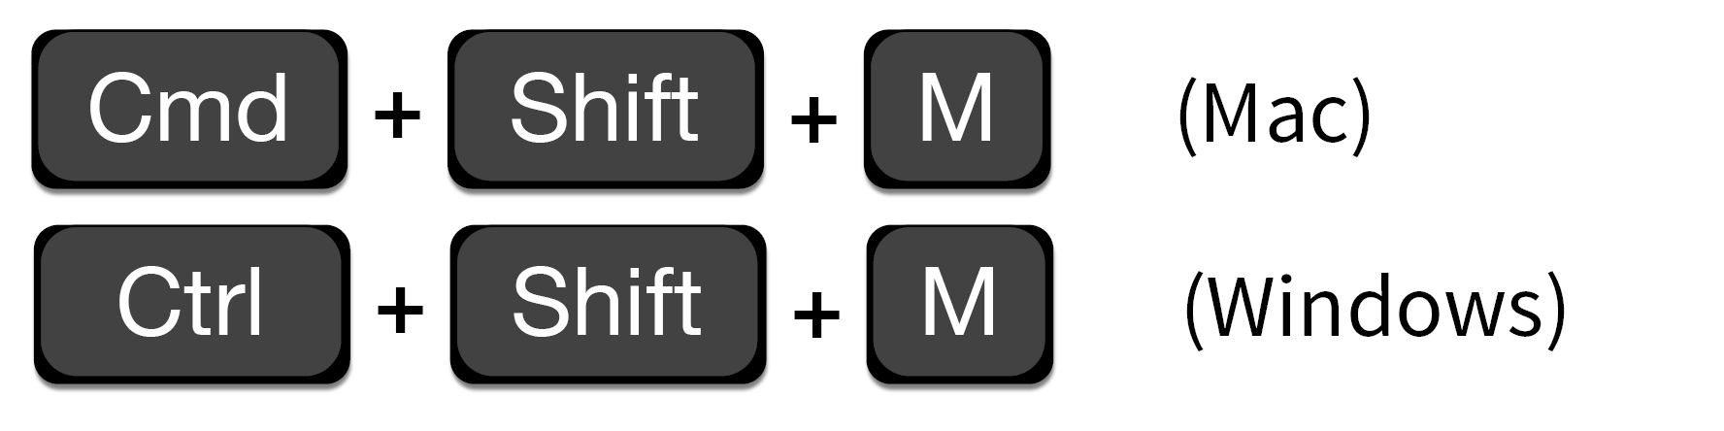
Shortcut to type %>%

Slide 64

Scene
The PICU would like a word with you because of a recent incident involving a delay in result for a patient who required a AGP
They had to wait over 10 hours before the procedure could begin
You decide to investigate… WITH DATA

Slide 65
Your Turn 6
Use %>% to write a sequence of three functions that:
1. Filters to tests not from the clinic (clinic_name) of "picu"
2. Selects the column with the receive to verify turnaround time (rec_ver_tat) as well as the day from start of the pandemic (pan_day)
3. Arrange the ` pan_day ` from highest to lowest
Using <-, assign the result to a new variable, call it whatever you want.

Slide 66
covid_testing %>%
filter(clinic_name=='nicu') %>%
select(rec_ver_tat,pan_day) %>%
arrange(desc(pan_day))

Slide 67
Isolating data
Extract variables with select()
Extract rows with filter()
Arrange rows, with arrange().
Notes:
So far we’ve covered functions whose primary job is to reshape your data but don’t fundamentally tell you something about what’s inside of it.

Slide 68
Deriving Data

Slide 69

What is the average and SD in total turnaround time by clinic?
Notes:
If you’re interested in orders for basic metabolic panels from September, then you can do that. However if you want to learn something from your data you have to summarize it. For instance, what if you want to know what your lab’s top three ordered tests are on weekends? You have the right data to answer that question, but we need to derive the answer from it.

Slide 70
Breaking down the analytical question
Total TAT for each test
Group tests by clinic
Calculate average and SD for each clinic
Notes:
To answer a question like the one we posed on the previous slide, it can help to break it down into the steps that we need to take to get to the finish line. In this case, we’re going to have to figure out which weekday the tests were ordered. We’ll probably be working with the order_time column for that. Then we’ll have to count the number of orders per test on the weekend. Finally we’ll have to put the in rank order.

Slide 71
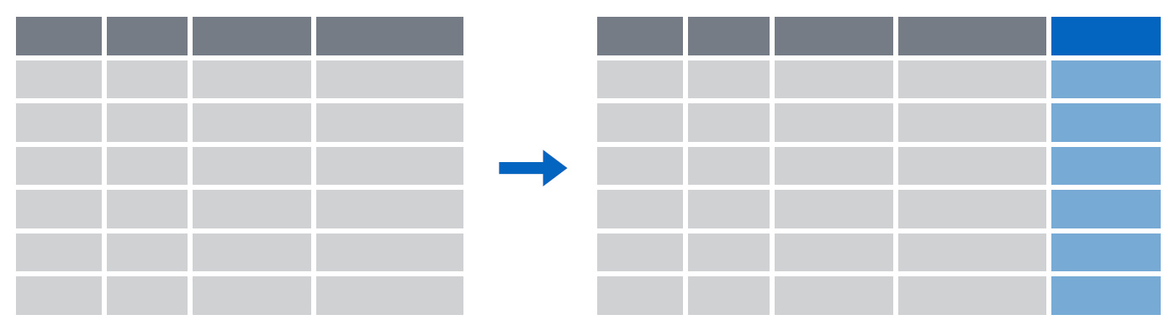
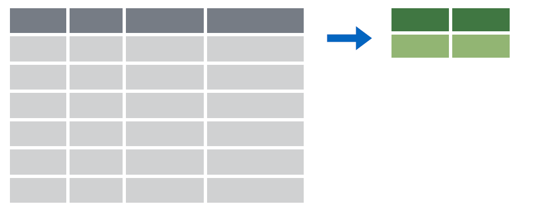
Deriving data
Make new variables with mutate()
Make summaries of data with summarize()
Notes:
To answer questions like these we’re going to need a new set of functions whose job is to derive new data from our original data frame. The two work-horse functions in dplyr to accomplish these types of tasks are mutate() and summarize().

Slide 72
mutate()
Notes:
We’ll begin with the mutate() function.

Slide 73
mutate()
Creating new calculated columns
= Number of rows
↑ Number of Columns
Notes:
The goal of mutate() is very simple. You’ll feed it your original data frame and it’s going to kick out the same data frame with one or more new columns tacked onto the end based on calculations that you specify.

Slide 74
mutate()
Creating new calculated columns
orders %>%
mutate(new_column = calculation)
function whose results will populate columns
name for new column
equals
Notes:
The syntax is going to look familiar to the functions we saw earlier but with a small change. As before, the first argument is the original data frame, which gets piped into mutate. Then you specify the name of the new column you want to add, you type of an equals sign, and then you write a calculation. This calculation will be run on each row of your data frame and the result will populate each row of the new column.

Slide 75
mutate()
calculation can involve another column in the data frame
Creating new calculated columns
covid_testing %>%
mutate(c_r_tat_mins = col_rec_tat * 60)
mrn | col_rec_tat | rec_ver_tat
5000876 | 29.5 | 11.5
5006017 | 3.6 | 5
5001412 | 1.4 | 5.2
5000533 | 2.3 | 5.8
mrn | col_rec_tat | rec_ver_tat | c_r_tat_mins
5000876 | 29.5 | 11.5 | 1770
5006017 | 3.6 | 5 | 216
5001412 | 1.4 | 5.2 | 84
5000533 | 2.3 | 5.8 | 138
Notes:
Let’s look at an example. Say we wanted to share our data set with a research collaborator. What we could do is create a new column, called for instance “coded_order_id” and set that equal to half the numeric value contained in order_id. In this situation mutate() would perform that calculation on each row and place the result in a new column at the right most part of our data frame. Note how in this example we essentially treat order_id like it’s a variable. This is a feature of mutate(). We can refer to values in other columns in the same data frame simply by referring to their name.
Note: I am not at all suggesting that this is appropriate practice when encrypting your data for sharing with a colleague.

Slide 76
Your Turn 7
Create a new column using the mutate() function that contains the total TAT (sum of col_rec_tat and rec_ver_tat)

Slide 77
covid_testing %>%
mutate(tot_tat = col_rec_tat + rec_ver_tat)

Slide 78
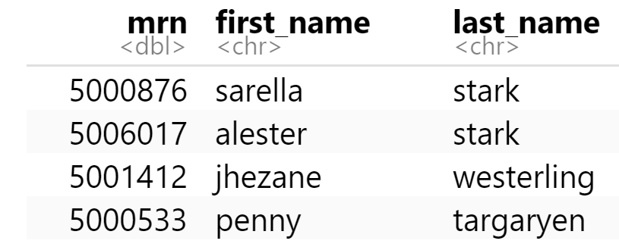
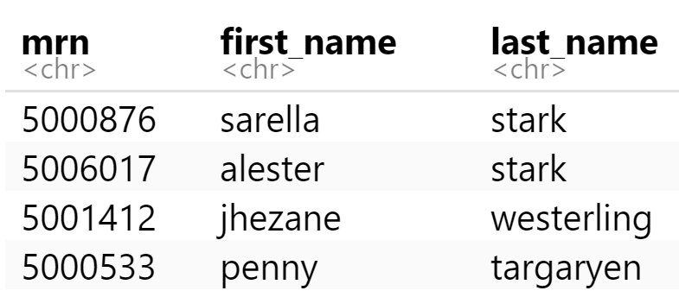
mutate()
Function to "coerce" one type of data into another type of data
Replacing columns
orders %>%
mutate(mrn = as.character(mrn))

Slide 79
data types in R
Type of Data | Function | Result of Function
Character | as.character(1) | "1"
Numeric | as.numeric("123") | 123
Logical | as.logical(1) | TRUE
Date | as.Date("05-06-2019") | NA
Notes:
alternative

Slide 80
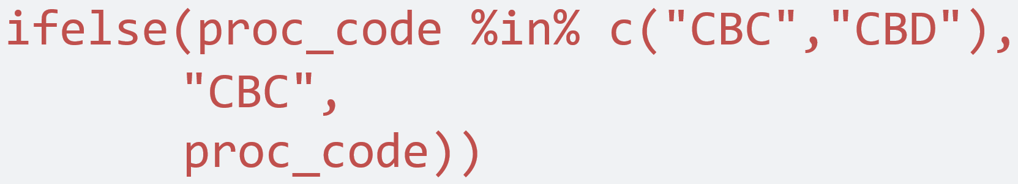
mutate()
Conditionally replace values in a column
orders %>%
mutate(proc_code =
ifelse(proc_code %in% c("CBC","CBD"), "CBC",
proc_code))
logical statement
value if true
value if false

Slide 81
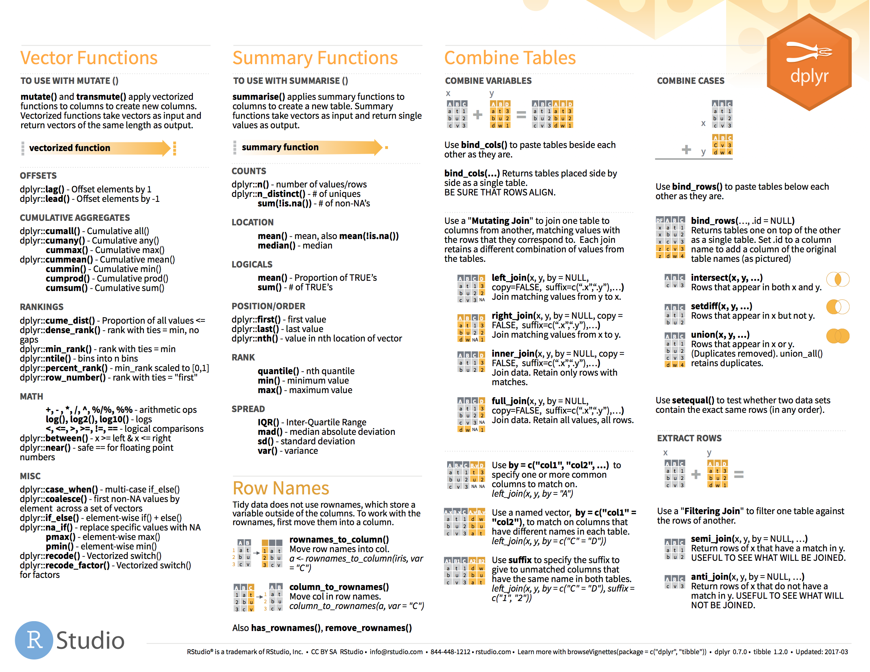
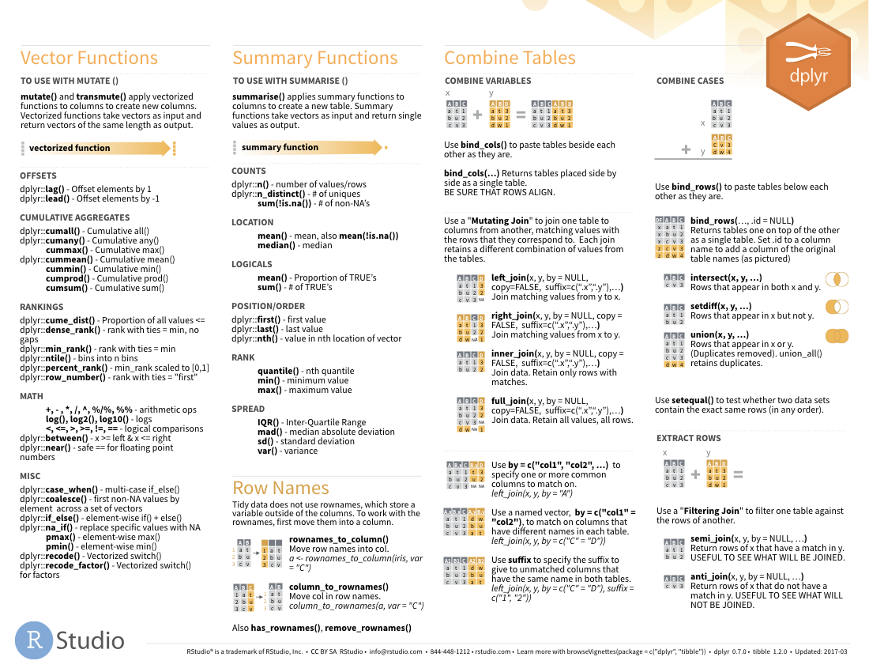

Functions to use in mutate()
on back
81

